Slide 1


An Evening of Bonsai Session B: Bonsai Aesthetics
Alex Labram
July 2024
Nemeta Bonsai
nemeta.co.uk

Slide 2
Learning Outcomes
Be aware of the history and culture of bonsai
Understand (at a high level) how a bonsai is produced
Understand (at a high level) what distinguishes good and bad bonsai
Know how to maintain a bonsai on a day-to-day basis
Experience the key activities of re-potting, pruning and wiring
Be aware of inexpensive options for further learning and practice
Practical component
Exposing the nebari
Pruning for bulk, congestion and taper

Slide 3
Review
First Week Highlights

Slide 4
I Had One Once, But It Died What a bonsai needs to survive
Environment
Indoor vs Outdoor
Watering!!!!!
Single biggest killer of bonsai
“Root hairs” die easily in drought
Over-watering is also dangerous!
Light
Heat
Dormancy
Airflow
Pest Control
Animals: spider mites, scale bugs, aphids, caterpillars, vine weevil, squirrels
Plants etc: pearlwort, liverwort, wood sorrel, pennywort, nostoc
Caution: environmental issues!
Fertiliser
“Balanced”: roughly even NPK
Organic => micronutrients
Caution: environmental & ethical issues!
Bonsai are far harder to keep alive than most common pot plants!

Slide 5

Bonsai: Art & Science
Good bonsai practice is:
Authentic - makes you think “tree”
Dramatic – makes you think “TREE”
Pragmatic – doesn’t make you think “dead tree”…

Slide 6
Authenticity & Drama
Thinking Like A Tree (That’s Seen Some S**t)

Slide 7
Arboriculture 101 What shapes a tree?
Sunlight
Airflow
Gravity / load
Shade
Animals

Slide 8
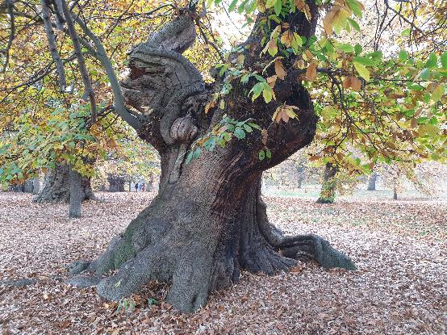
Authenticity & Age What makes a tree look mature?
Canopy shape
Rounded triangle
Composed of rounded-triangle “pads” (for species that back-bud less readily)
Trunk & branch behaviour
Short inter-node distance
“Ramification”: fractal splitting of branches
“Square-cube law”: big tree = proportionally heavier load = more curvature
“Ruptures”: jagged direction changes
Texture
Bark
Dead-wood: advanced bonsai topic!
Taper
“Nebari” (根張り) = root flare
Trunk & branch flare: base to apex / tip
Trunk-to-branch ratio

Slide 9
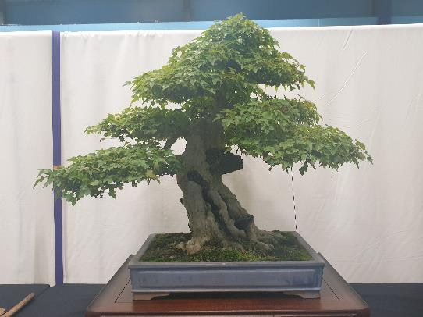
Drama & Perspective What makes a tree stand out?
Taper (again!)
Taper appears stronger from viewpoint at base of tree
Pot: picture-frame for tree
“Heavy” earthenware vs “light” glazed
Depth ≈ trunk thickness; width ≈ 2/3 canopy height (tall tree) or width (wide tree)
Style: heavy vs light, plain vs ornate
Use of negative space
…Often justified as effect of wind-flow or trunk death
Scaled-down decorations
Moss “grass”, accent plants, rocks (“suiseki”)
Well-defined “front”
Style is firmly established
Sense of strength or movement captured
Clear view of lower trunk
No crossed branches
Tree’s “centre of mass” is in middle of pot

Slide 10
Flaws What gives the game away?
Obvious tool marks
…Including wire scarring
Excessive symmetry
…Especially handlebar branches
Asymmetry is a common theme in Japanese gardening!
“Reverse taper”
Unusual “habit” for species / genus
Google for pictures of wild tree to get ideas!
This rule is frequently ignored: e.g. small shrubs portrayed as large trees, boringly-shaped species made interesting, unrealistic pads
Dead leaves and (unwanted) deadwood
“Weak” branches
Suckers
Congested nodes
Under-slung / elbow branches
Lack of clear “leader” (dominant trunk / branch)

Slide 11
Bonsai Styles The most common four of… thirty? Really?!?
Formal Upright
Cascade
Strong, proud, “yang”
Pot: unglazed earthenware; simple shape; bulging
Can be hard to develop taper
Flowing, falling
Pot: deep to make space
“Half-cascade” runs to base of pot; “cascade” goes below that
Informal Upright
Literati
Relaxed, elegant, “yin”
Pot: glazed; fluting; flowery
Broad range of possible shapes
Basically the default style!
Solitary, melancholy, bleak
Trunk: bare, ruptured, calligraphic
Pot: small to emphasise plant’s extravagant loneliness
Style derived from woodcuts in classic Chinese drawing guide

Slide 12
Thanks For Attending!

